Slide 1
Tech@venture Singapore Doing business in Singapore
May 24th 2023

Slide 2
Agenda
Quick intro GVB
Nallian
What do we do?
The Nallian Singapore story
Doing business in Singapore
Q&A

Slide 3
Geert Van Brempt
Managing Director APAC, Nallian

Slide 4
Nallian

Slide 5
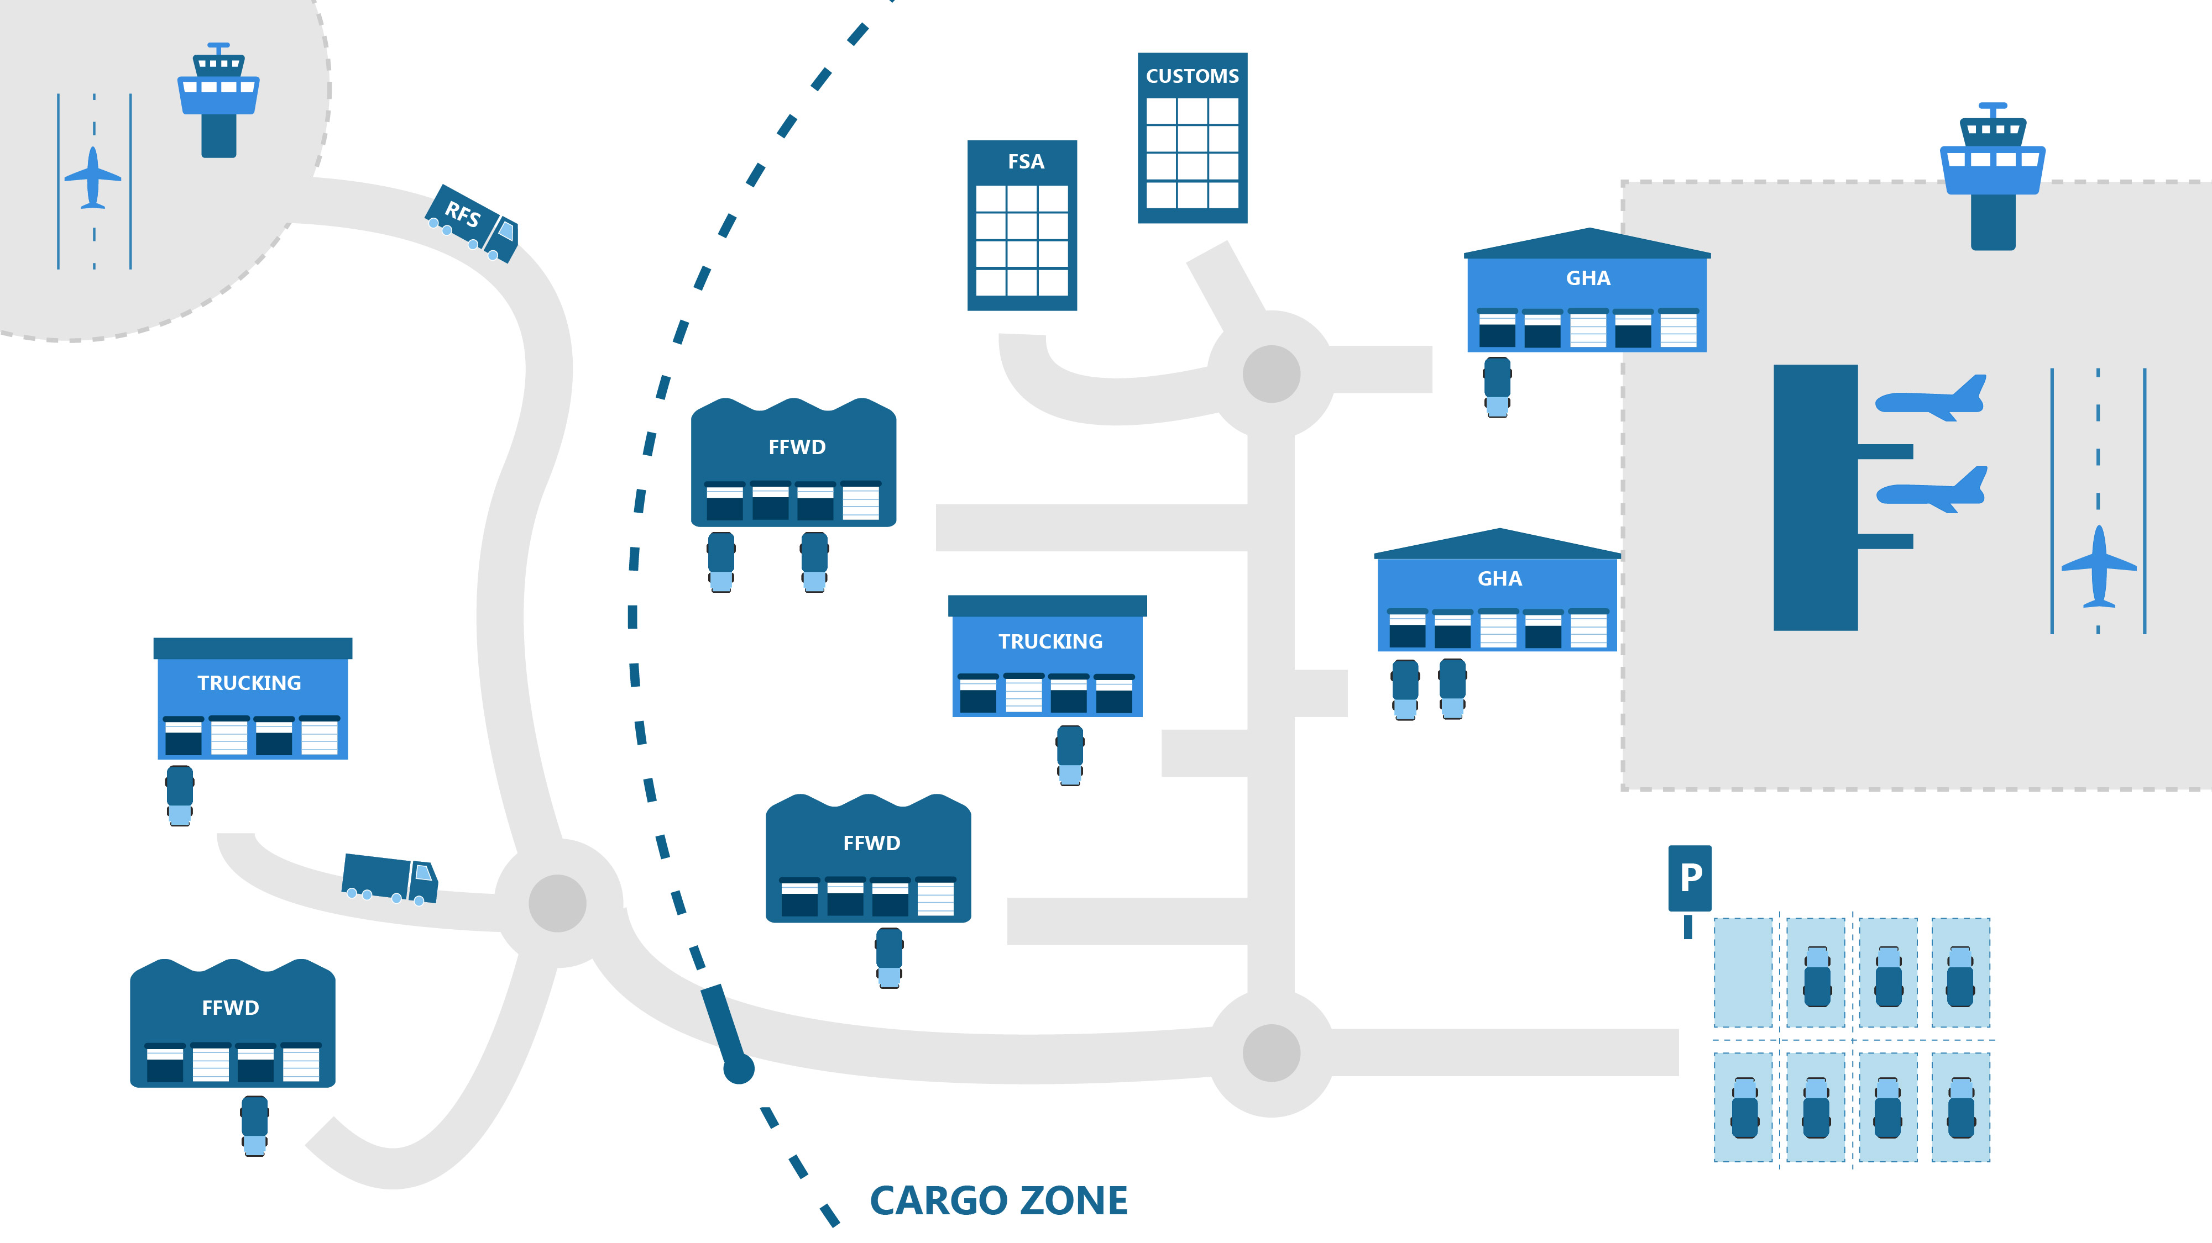
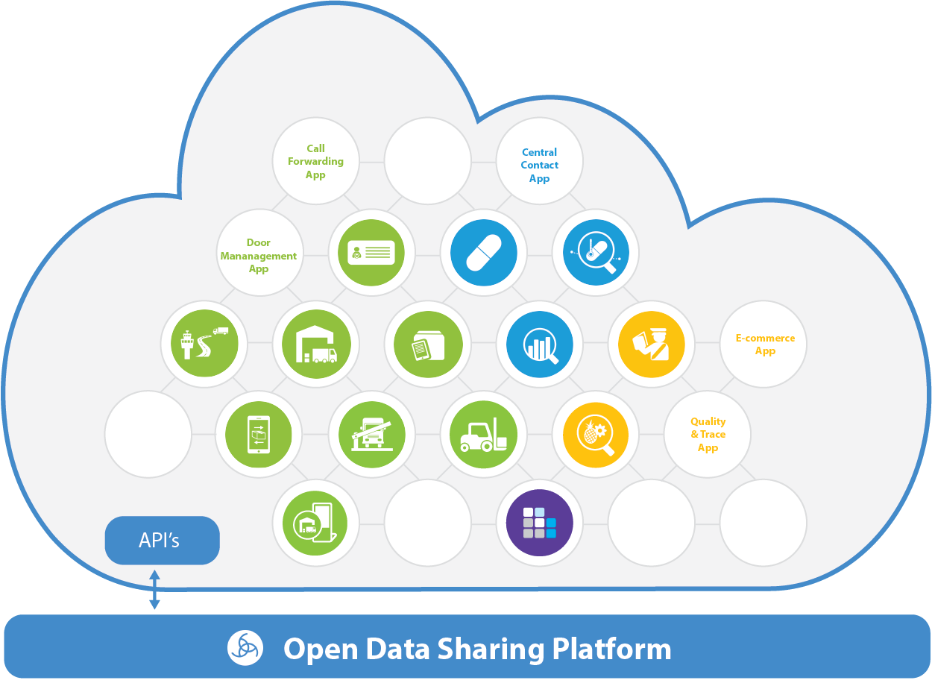
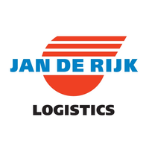
Champ
Hermes
Accelya
Unisys
CCN
McKinsey
…
Efficiency
Visibility
Control
EU
USA
ASIA
Brussels
Singapore
Vietnam
40
& growing

Slide 6
A clear mission
Making the world
Operate as One

Slide 7
The Traditional Air Cargo Industry
Manufacturer
Trucker
Freight forwarder
Airline Cargo handler
Airline
Airline Cargo handler
Airline
Airline Cargo handler
Trucker
Freight forwarder
Trucker
consignee
A fragmented industry
Inefficiencies – low degree of digitization / highly manual process
Little innovation by the incumbent players

Slide 8
+8 HOURS
+32 HOURS
+34 HOURS
+72 HOURS
+24 HOURS
+64 HOURS
delays in data flowing across companies
causes lack of overall visibility
which makes network-wide optimization impossible

Slide 9
Integrators manage the logistics chain → how can the traditional cargo industry learn from this?
Manufacturer
Trucker
Freight forwarder
Airline Cargo handler
Airline
Airline Cargo handler
Airline
Airline Cargo handler
Trucker
Freight forwarder
Trucker
consignee
Growing the air cargo industry and their market share
More expensive – but more efficient and transparent
Higher profitability, higher investments, innovation

Slide 10
To an Intelligent Air Cargo Supply Chain
Manufacturer
Trucker
Freight forwarder
Airline Cargo handler
Airline
Airline Cargo handler
Airline
Airline Cargo handler
Trucker
Freight forwarder
Trucker
consignee
A connected industry
Efficiencies – focus on cross company processes
Innovation by communities and new enablers
Transparency for all stakeholders

Slide 11
Nallian offers a cloud-based data sharing solutions
that help networks of logistic partners collaborate and operate as one

Slide 12
Some of the amazing cargo communities we’re working with
BRU
LHR
OST
dnata | AMS
Menzies |LAX
DFW
LGG
VIE
ATH
SIN
Menzies |MEL
Notes:
One of the strengths of Nallian is that implementing Cargo Community Systems at Airports is already for a decade our core business! We are active on 3 continents (even 4 if you consider Oceania a separate continent). A very strong presence in Europe with implementations and operations at Brussels, Liege, London Heathrow, Vienna and Ostend. But also in Asia (with Singapore and Melbourne) and America (Dallas and LA).
So we have learned a thing or 2 along the way… ☺

Slide 13
Nallian Product offering
Building Connected Cargo Communities
Building lane views across communities – shipment centric view
Cargo Cloud – Cargo Community System
Community centric data model – CargoFlow
Multimodal / Lane Solutions
Truck Visit Management
Check-it
Inspection Management
Cargo Statistics
(Airport) Community Solutions
Streamline the landside pick-up and drop off process
___
GHA, FFWD, Trucking
Digitize question-based operational and compliance checks/tasks
__
GHA, FFWD
Facilitate coordination of the inspection of goods (PER+AVI)
___
GHA, FFWD, Authorities
Provide granular insights in end-to-end cargo streams __
Airport operator
Products

Slide 14
The Nallian Singapore story
CAG – world tour (including BAC)
Want similar solution to Brussels
RFP process
Nallian get awarded the contract
Cargo DiGi-CO Workshop organized
Use Cases defined and chosen
Trial period / Implementation
Further development of APAC
Roll-out across complete Air Cargo Community @ Changi
Set up of Nallian Singapore Pte Ltd
GVB hired

Slide 15
Doing business in Singapore
A couple of findings I’d like to share

Slide 16
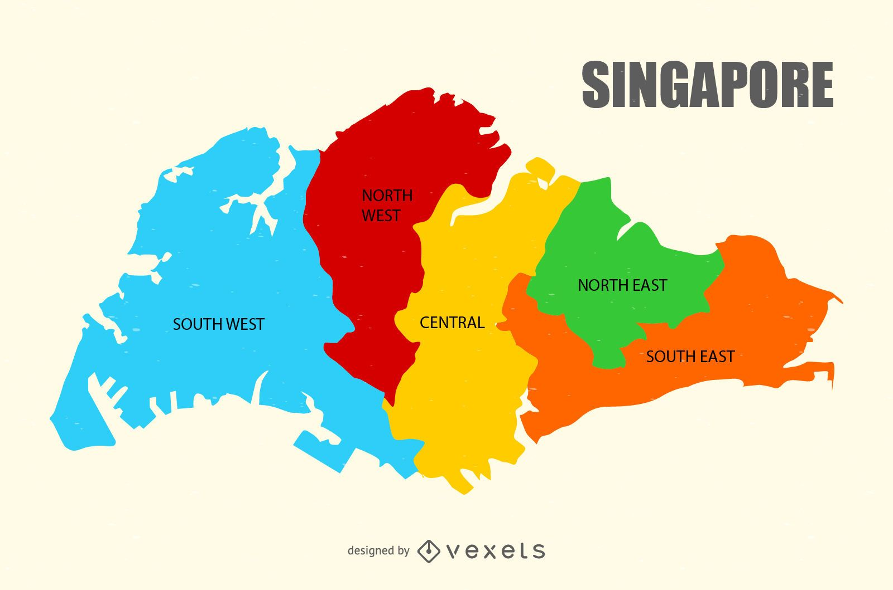
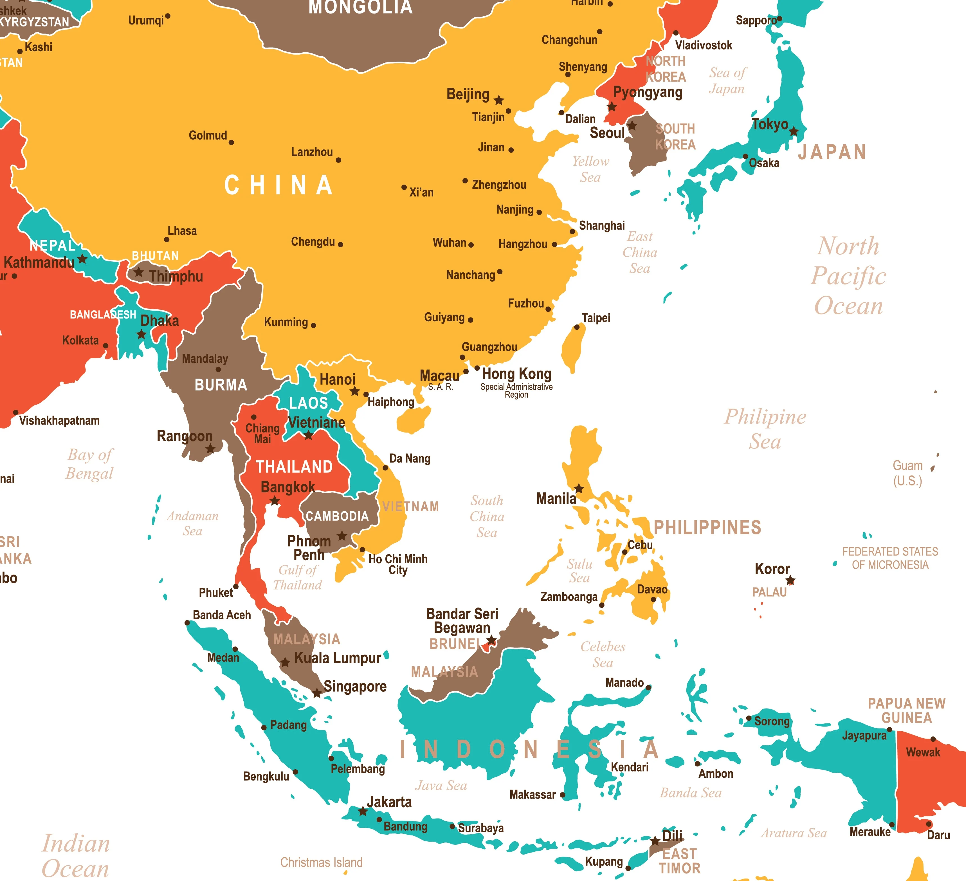

Slide 17
Singapore Business environment / Government
Country run like a company https://ukdiss.com/litreview/how-singapore-and-malaysia-dealt-with-financial-crisis.php
Very business oriented
Employer protected
Easy to set up companies
Low (Corporate) taxes
Lots of Government support
Real, long term planning https://www.straitstimes.com/multimedia/graphics/2021/08/sg-2030/index.html?shell

Slide 18
Singapore Business environment / Government
But…
Expensive…
Since Covid – more “eigen volk eerst”…
Next year’s election…
China’s influence increasing…

Slide 20
Saving/Losing Face

Slide 21
Q&A

Slide 22
Geert Van Brempt | Managing Director, Asia Pacific

