Slide 1
Jenthe van Gastel
Singapore 2020
Starting up a new office/market for Faktion
Notes:
Jenthe – currently working for Proximus as Service design team lead
3 years ago, I worked for Faktion and I was responsible for starting up business activities for them in Asia, setting up their first Singapore office

Slide 2
Agenda
Introduction
Faktion & Metamaze
Prince Albert Fund
My Singapore experience
Timeline & context
Lessons learned
Q&A
Notes:
jullie te laten vertellen over de go-to-market in Singapore met Faktion, jullie ervaringen, plan van aanpak en lessons learned, … en hoe de samenwerking van de werknemer ter plaatse (Jenthe, via PAF) en het thuisfront in België (Niels en team) verliep en hoe jullie dit aanpakten. En nadien de ruimte te laten voor vragen.

Slide 3
About the company
Notes:
jullie te laten vertellen over de go-to-market in Singapore met Faktion, jullie ervaringen, plan van aanpak en lessons learned, … en hoe de samenwerking van de werknemer ter plaatse (Jenthe, via PAF) en het thuisfront in België (Niels en team) verliep en hoe jullie dit aanpakten. En nadien de ruimte te laten voor vragen.

Slide 4
PAF supports the Belgian economy by matching fast-scaling companies with high potential Belgian young professionals.
The mission of the Prince Albert Fund is to:
Contribute to the development of the Belgian economy by enabling promising Belgian companies to exponentially scale their international growth
Help talented young professionals develop their international leadership potential
Application letter & CV
Case & motivation for jury
Leadership training
Project search & selection
Jan 2019
Mar
May
Apr - Sept
Notes:
I really wanted to go for a tech scale-up, because technology has always interested me
While there’s the possibility to go work for a big corporate with an already existing abroad team, I wanted to experience the most entrepreneurial experience possible – going by alone all by myself to go really out of my comfort zone and explore if some day I could maybe do this for myself
About 20 candidates out of 300 finally get selected
Some criteria: masters degree, some years of working experience, international touches, examples of resilience, courage, …

Slide 5
Dec 2019
First weeks in Belgium
Goal: Lay the foundations for sustainable long-term APAC presence (office(s), team, partnerships, …)
First weeks: preparing in HQ
Familiarize with Faktion products & services
Defining first milestones, targets & budget
Cost of living, office space, appointment of local managing director…
First visit to Singapore with CEO
Arrange practicalities: work permit, setting up Faktion ltd
Jan 2020
Mar - May 2020
Jun - Nov 2020
Dec 2020
Notes:
Drive (new & existing) sales, business development and marketing activities for APAC region with support from local Managing Partner & Antwerp team

Slide 6
Dec 2019
First weeks in Singapore
Setting up finding a (shared) office space
Finding an apartment
Meeting with existing customer accounts & partners
Local managing director quit
Learning-by-doing approach → struggling
Jan 2020
Arriving in Singapore
Mar - May 2020
Jun - Nov 2020
Dec 2020

Slide 7
Dec 2019
Lockdown period
No / very slow business activity both in Belgium & Singapore
With everything becoming virtual, shifted to LinkedIn but with limited success
Pivot in BD: joining online business communities, automated email drip campaigns, Lunchclub.ai
Pivot in focus:
Market research & trainings about AI
Local Project management
Website copy writing
…
Jan 2020
Mar - May 2020
COVID 19 Period
Jun - Nov 2020
Dec 2020

Slide 8
Dec 2019
Slowly back to “new normal”
Positioning our products rather than our custom services
Exploring partnerships with local IT integrators
Continued networking, leveraging Belgian / EU expat networks
First deal in August, 3 more in the following months
Jan 2020
Mar - May 2020
Jun - Nov 2020
From light activity to “new normal”
Dec 2020
Notes:
- Tech world, it takes time before you really land a deal

Slide 9
Dec 2019
Jan 2020
Mar - May 2020
Jun - Nov 2020
Dec 2020
Going back home
Notes:
- Tech world, it takes time before you really land a deal

Slide 10
Lessons Learned
Importance of status / credibility
In your own function title: (Vice-)President, Director, Head of, …
Credibility through reference cases with well-known companies
Buzz vs real expertise
Notes:
jullie te laten vertellen over de go-to-market in Singapore met Faktion, jullie ervaringen, plan van aanpak en lessons learned, … en hoe de samenwerking van de werknemer ter plaatse (Jenthe, via PAF) en het thuisfront in België (Niels en team) verliep en hoe jullie dit aanpakten. En nadien de ruimte te laten voor vragen.

Slide 11
Lessons Learned
Importance of trust / relationships
Relationship building is key
Network events, (family) dinners, coffee, after-work, …
WhatsApp as communication channel, high expected responsiveness
Local SPOC for account & project management
Notes:
Brought daughter home

Slide 12
Go-to-market strategy
Products work better than customized solutions
Qualitative proposals are appreciated but day rates of competing Asian IT consultancies / integrators are drastically lower
Our products had proven track record in EU
Products also allow for local partners to implement them
Education angle: e.g. training, webinars, own events
Choose verticals wisely
Look for companies with local decision making power (Utilities, logistics, food, …). A lot of International / Financial companies use Singapore as gateway + tax benefit, but decision making power for projects is limited
Local government is THE best reference
Investigate government grants for your clients
Need for a business developer who likes hunting for leads
Notes:
Brought daughter home

Slide 13
Lessons Learned
Collaboration with HQ
Participating in weekly sales stand-up
Measuring targets in shared CRM
Importance of proximity of founder
Regularly working 2 time zones
Notes:
Brought daughter home

Slide 14
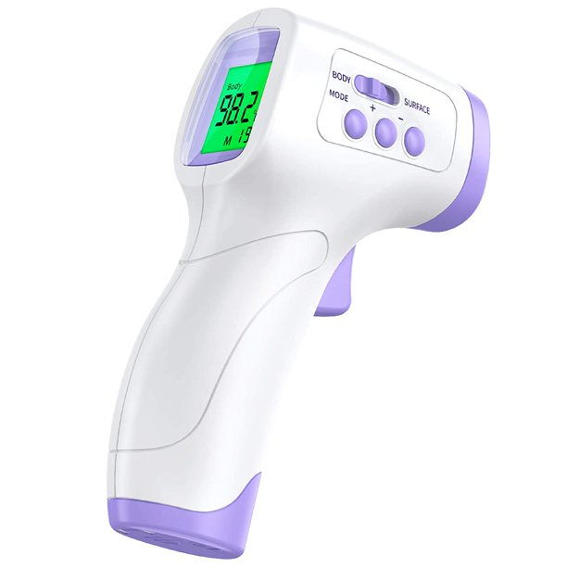
Questions?
Shoot!
Notes:
Anecdote Singapore government regime, very strict. At some point everyone needed to wear a tracker
List your assumptions
Leverage network
Connect with peers / people to share experience
Explore efficiencies
Automate repetitive (business development) tasks
E.g. Prospect.io, Dux-soup, Hunter.io, …
Templates
E.g. prospect emails, sales deck, proposal template
Lunchclub.ai (AI “super connector”)

