Slide 1
Labour Market in Singapore
Mok Kai Lynn
Corporate & International Relations Director, APAC

Slide 2
2022 Labour Market Overview
Source: The Labor Market Report 2022 by Ministry of Manpower (MOM) of Singapore
Residents refer to Singapore Citize​ns and Permanent Residents
Notes:
Highlights of the Report:
Significant improvement from 2021
Unemployment at pre-pandemic level
Retrenchments generally stayed low, despite the latest quarter’s rise
Retrenchments rose in 4Q 2022 from the lows of the previous three quarters and were largely due to business reorganization or restructuring. The increase mainly reflected higher retrenchments in Information & Communications, Electronics Manufacturing and Wholesale Trade, while retrenchments in other sectors remained stable.)
Labor Turnover: When job openings are plentiful, resignation and recruitment rates tend to be high, reflecting movement of workers between jobs. Conversely, the rates tend to be low during periods of economic downturn.

Slide 3
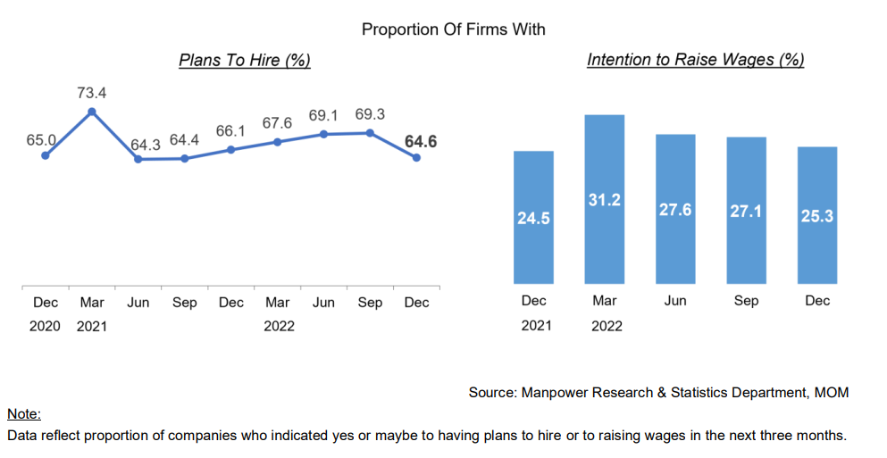
2023 Expectations
Notes:
“Based on company polls, hiring sentiments remain positive in the coming months, while the proportion of firms with intention to raise wages in the next three months fell slightly. Firms could have become more cautious in recent months in view of the high inflation and geopolitical uncertainties.
The projected slowdown in economic growth in 2023 would likely have some impact on the momentum of labor market improvements. With the recent uptick in retrenchments, unemployment rates could also trend higher.”

Slide 4
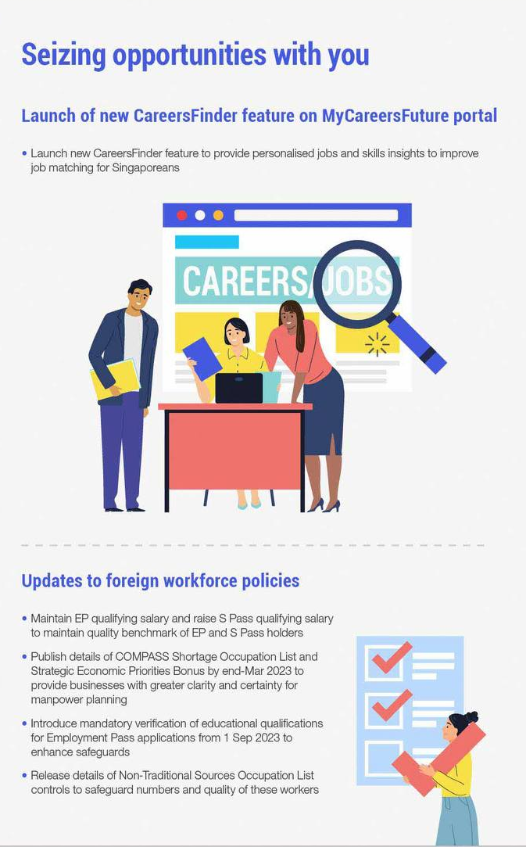
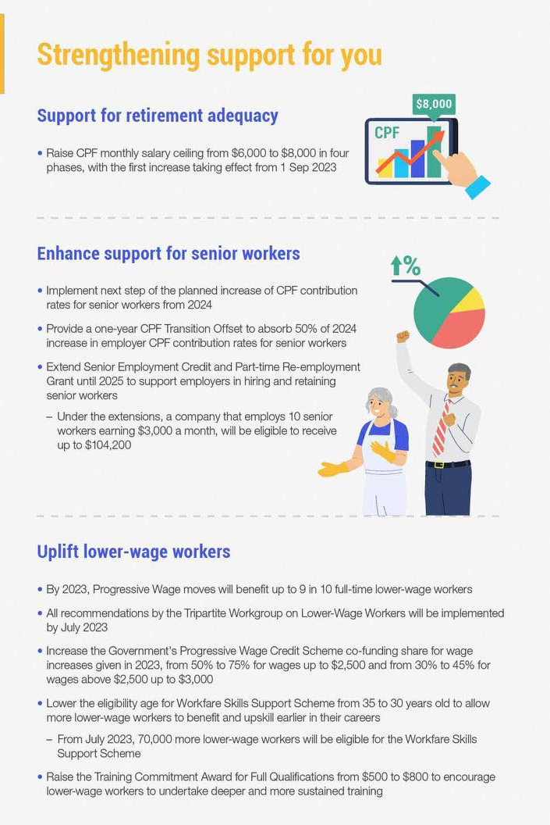
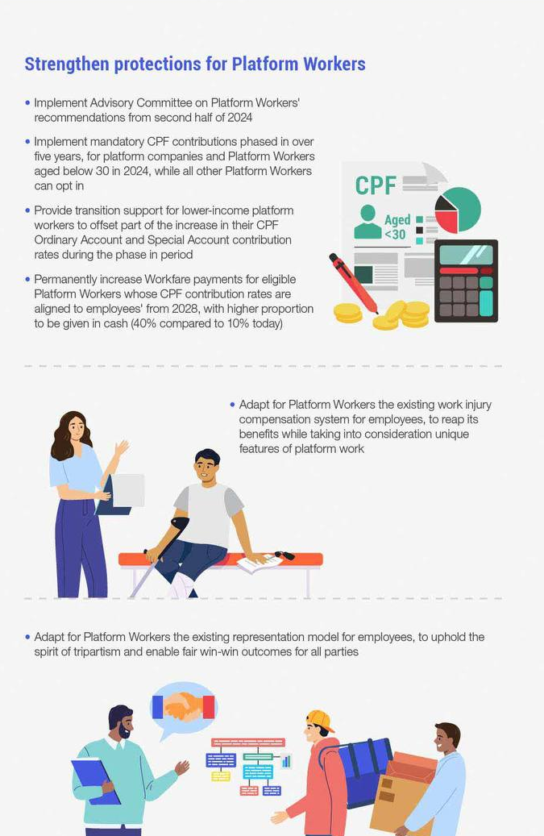
Minister of Manpower Committee of Supply Highlights 2023
Notes:
Labour market posted strong growth lats year
However, in the uncertain global economic environment, global inflation, and geopolitical challenges in the medium term will weigh on the labour market going forward
Efforts to understand Singaporeans’ aspirations and anxieties about the economy and jobs

Slide 5
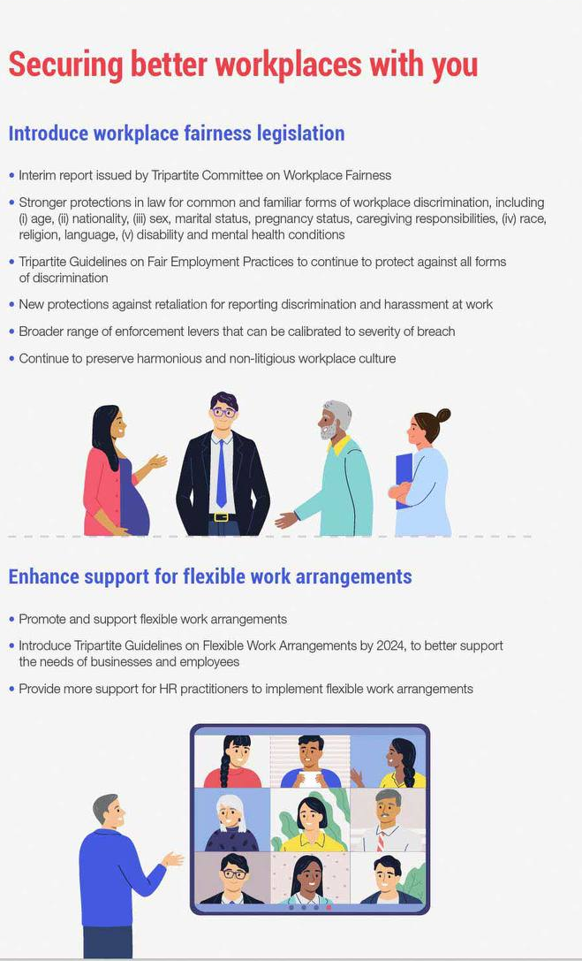
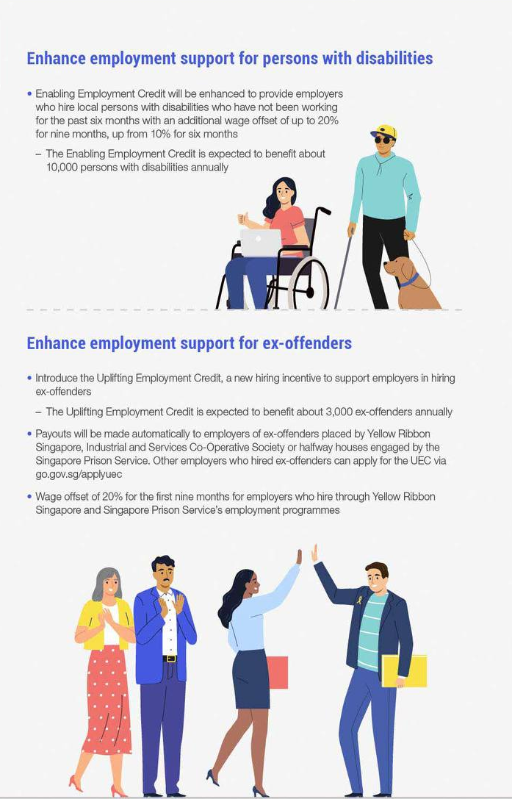
Minister of Manpower Committee of Supply Highlights 2023
Minimum qualifying salary for EP and S Pass renewals will increase from 1 Sep 2023
Complementary Assessment Framework in force for new applications from 1 Sep 2023
New points-based system
Foundational criteria
Bonus criteria
Exemptions apply for high-earning candidates
New “ONE Pass” for top talents
Notes:
Applicants must score at least 40 points to pass
Bonus criteria – Selected skills in demand, Innovation / internationalization
5 year golden visa for top talents earning $30,000 per month available since 1 Jan 2023 but backlog.

Slide 6
Singapore HR trends and issues to look out for in 2023
Fighting the talent war
Remote and Hybrid Work
Foster mental health and well-being for employees
Provide upskilling and learning opportunities for employees
Increased focus on Diversity, Equity, and Inclusion (DE&I)
Address quiet quitting
Notes:
Moving towards or has been looking at tangible aspects - pay and benefits as major competitive battlegrounds
Beyond pay increments, companies in Singapore are also making other adjustments in the form of mental health benefits, bonuses, flexible working policies and more.
Adjustments in the form of mental health benefits, bonuses, flexible working policies and more.
Remote and Hybrid Work: In a recent Institute of Policy Studies (IPS) report, 52% out of 2,000 Singapore workers felt that flexible work arrangements (FWA) should be the new norm. The general sentiment is that hybrid or remote working allows them to juggle personal and work commitments better.
2. Mental health and well-being：According to an inaugural study, stress-related illnesses have far more significant implications – costing Singapore’s economy about S$3.2 billion a year and forming about 18% of the country’s total health expenditure.
3. Upskilling and learning: According to LinkedIn’s 2019 Workforce Learning Report, 94% of employees say they would stay at a company longer if it invested in helping them learn.
With digitalisation at the heart of it all, many companies are leaning towards establishing a work culture that promotes and facilitates the open sharing of knowledge, insight, and experience that benefits employees and drive a company toward important strategic goals.
5. DE&I: Ethnicity background of SG, also a survey report by the Singapore National Employers Federation and Kincentric found that 71% of employers recognised the positive impact of DEI on company culture, and 55% recognised its impact on employee engagement.
4. Quite quitting: A recent study by Deloitte pointed out that younger employees are increasingly seeking flexibility and purpose in their work and balance and satisfaction in their lives. Hence, many are rejecting the live-to-work lifestyle.
“Leaders have an obligation to address this – not least for the wellbeing of their employees, but also to drive the productivity of their organisations,”

Slide 7
Singapore Workplace Culture
Large western MNCs in Singapore will often exhibit predominantly western-style work culture.
Majority of local government and private companies will have greater influence of traditional Asian culture in their work environment.
Cosmopolitan
Multiracial
Melting Talent Pot where East Meets West
Globally renowned “Hub” status
Diverse Workforce
Gateway to SEA

Slide 8
Searching for Talent in Singapore
Job searching platforms:
General positions
LinkedIn
JobStreet
JobsCentral
MyCareersFuture
Start-ups
e27
Tech in Asia
StarUp Jobs Asia
Part-time
FastJobs
Freeboh
Interns
InternSG
Job advertisements cannot discriminate against job applicants on the basis of age, gender, race, religion, marital status, language or disability.
Job seekers who find unfair or discriminatory language in a job advertisement can report it directly to TAFEP (Tripartite Alliance for Fair and Progressive Employment Practices).
Notes:
Unfair or discriminatory terminology such as:
Age: at least 25 and older; under 30; 25 to 40; younger candidates, etc.
Gender: male only; female preferred, etc.
Ethnicity: Chinese preferred; Chinese only; Chinese speaking work environment, etc.
Language: Bilingual preferred; Native English; Chinese speaker preferred, etc.
Nationality: Singapore Citizen/Singapore PR preferred; working visa holders only, etc.
Marriage: Married only; Unmarried only

Slide 9
Labour Laws and Regulations
Item | Laws and Regulations
Duration of employment contract | Generally open-ended contracts
Probation | No specific provisions, subject to the consensus of employment parties
Minimum monthly salary | No specific provisions
Social Security and Central Provident Fund (CPF) | Singapore citizens and Singapore PR holders, not applicable to foreign worker visa holders or other pass holders Central Provident Fund (CPF) ≤ 55 years old: 17% for company; 20% for employee ＞Age > 55, ≤ 60: Company 14%; Employee 14% ＞60, ≤ 65 years old: Company 10%; Employee 8.5% ＞65, ≤ 70 years old: 8% of the company; 6% of the employees > 70 years old: company 7.5%; employees 5%
Corporate Insurance | 1. Work Injury Insurance (WIC) For all local and foreign employees, the company must pay 1.5% of the employee's monthly income. 2. Skills Development Grant (SDL) For employee skill enhancement, full time, part time and foreign employees, the company is required to pay SGD 2 to SGD 11.25 based on the employee's monthly income x 0.25%.
Other benefits | Company group commercial insurance: outpatient, hospitalization, dental and accident and death insurance
Annual Employee Personal Tax Return | The company must complete and submit to the Inland Revenue Authority of Singapore (IRAS) a return of salary-related income for the previous year for each eligible employee, and a return of salary-related income for foreign employees when the foreign work visa holder leaves the company and submit it to IRAS

Slide 10
Item | Laws and Regulations
Statutory Public Holidays | 11 days, reflecting multi-racial characteristics
Paid annual leave | Determined by length of employment with the new company Employment ≥ 1 year: 7 days; after that, 1 additional day per year up to 14 days Most local companies give employees 12-20 days of paid annual leave in the first year of employment, depending on the industry or job level.
Paid sick leave | Employment ≥ March: 5 days of outpatient leave, 15 days of inpatient leave Employment = April: 8 days of outpatient leave, 30 days of inpatient leave Employment = May: 11 days of outpatient leave, 45 days of inpatient leave Employment ≥ June: 14 days of outpatient leave, 60 days of inpatient leave Note: The above days of outpatient leave are included in the number of days of inpatient leave
Maternity leave Shared parental leave | 12 weeks or 16 weeks for female employees who are eligible for maternity leave Eligible male employees can apply for up to 4 weeks of shared parental leave from their spouse's 16 weeks of paid maternity leave
Paternity leave | Employment ≥ March, 2 weeks paid paternity leave for eligible male employees (the child is a Singaporean citizen and the child's mother is legally married to him at the time of pregnancy and birth)
Parental leave | Employment ≥ March, child is a Singapore citizen, regardless of how many children the couple has, both parties are entitled to 6 days of parental leave per year until the child reaches 7 years old
Adoption leave | 12 weeks, with different actions performed on a case-by-case basis
Unpaid infant care leave | Employment ≥ March, child is a Singapore citizen and under 2 years old, including legally adopted children or stepchildren, employee can apply for 6 days
Military Service National Reservist Training (NS) | Singapore male citizen or second-generation male PR, as notified by government authorities
Extra hours | Applicable to non-manual workers with monthly salary ≤ S$2,600 or manual workers with monthly salary ≤ S$4,500 Weekdays: 1.5 times Weekends: Varies depending on which party is requesting overtime Company request: 1 day's pay/2 days' pay/2 days' pay + 1.5 times the additional hours Employee-initiated: 0.5 per diem/1 per diem/1 per day + 1.5 times the additional hours Public holidays: 2x or compensatory time off
Leave and Overtime

Slide 11
www.biposervice.com
bipo-svc
Biposvc
BIPOCHINA

Slide 12
Salaries in Singapore
Tech company positions(for reference) | Monthly salary (SGD)
Web developer | SGD 6,600
System analyst | SGD 7,500
IT analyst/application analyst | SGD 8,000
Software engineer | SGD 8,300
Back-end engineer | SGD 8,300
Senior software engineer | SGD 10,000
Application/Software development lead | SGD 13,500
Cloud engineer | SGD 8,800
Senior Cloud engineer | SGD 11,600
Development operations engineer | SGD 10,000
Senior development operations engineer | SGD 11,600
Development operations manager | SGD 15,000
Data engineer | SGD 7,250
Business Intelligence analyst | SGD 7,750
Database manager | SGD 8,000
Network security engineer | SGD 8,000
IT framework architecture manager | SGD 9,000

