Slide 1
Introduction to KBC Asia Pacific We go the extra mile for our clients

Slide 2
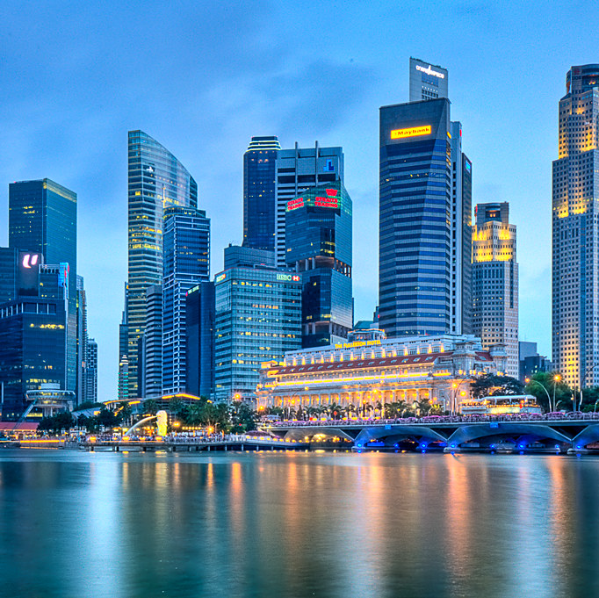
We are present in the 3 major financial centres in APAC providing wholesale banking services
SINGAPORE
HONG KONG
SHANGHAI
Since 1993
Since 1998*
Since 1996
Our 3 APAC branches offer an invaluable and specialized local banking support for subsidiaries of KBC clients with headquarters in a KBC core market.
In each branch, a dedicated multilingual European Desk is focused on making banking as easy as possible.
We are committed to be your European Banking Partner in APAC, who understand your business and banking needs better than anyone else.
* Prior to 1998, KBC Hong Kong operated under the name Kredietbank since June 1989
2

Slide 3
OUR APPROACH
REGIONAL SCOPE
to serve the home markets
What our customers appreciate
ONE BANK
ONE TEAM
Vast experiences & established network to address client’s specific business needs in APAC
Translating local needs into the right service solution
Seamless collaboration & coordination with the Relationship Manager in the home market
Dedicated & approachable teams to ensure professional and client-centric assistance
Fast credit approval thanks to our client knowledge, cooperation with Belgian colleagues and local decision authority.
China, Hong Kong and Singapore
+
extension to neighboring SE Asian countries
OUR MISSION
Make
banking in Asia
easy for KBC Group clients
Local teams ensure an extension of the services clients are used to by their main KBC contact.
3

Slide 4
KBC COMMERCIAL BANKING
Products and Services
Account openings in major international currencies, incl. RMB
Linking the local accounts to your e-banking platform in Europe
Cheque book issuance
Cash pooling / concentration: zero / target balancing.
Cash Management
Debt financing of your local entity – Credit on stand-alone basis or based on your credit profile and KBC relation in Europe
Working capital and investment credit solutions
Tailor made solutions to serve your local banking needs
Financing
Highly experienced trade finance desk with a dedicated contact person
Import and export invoice financing
Documentary credits, trust receipt, bank guarantees, performance bond
Trade Finance
In house dealing room in each branch
Tailor made solutions for your FX and interest rate hedging needs
Derivatives
Treasury
RMB current accounts in CNH and CNY and RMB Deposits
Cross-border RMB payments
RMB forwards for hedging purposes
Trade Finance services in RMB (RMB LC opening, Discounting of RMB LC)
Financing in RMB – Short Term Advance in RMB
RMB
4

Slide 5
KBC COMMERCIAL BANKING
KBC Bank NV Shanghai
Relevant Information
KBC Bank NV Shanghai
Room 2703/2708, Taikang Insurance Building
No. 429 Nanquan North Rd.
Pudong New Area, Shanghai 200120
China
Head of Commercial Banking
Skip Zhang
T: +86 21 6823 6277
E-mail: bin.zhang@kbc.be
Website: www.kbc.be/china

Slide 6
KBC COMMERCIAL BANKING
KBC Bank NV Hong Kong
Relevant Information
KBC Bank NV Hong Kong
Suite 3901, 39/F, Central Plaza
18 Harbour Road, Wanchai
Hong Kong
Head of Commercial Banking &
Deputy General Manger
William Ip
T: +852 2879 3407
E-mail: william.ip@kbc.be
Vice President, European Desk, Commercial Banking
Florence Chan
T: +852 2879 3380
E-mail: florence.chan@kbc.be
Website: www.kbc.be/hongkong

Slide 7
KBC COMMERCIAL BANKING
KBC Bank NV Singapore
Relevant Information
KBC Bank NV Singapore
9 Raffles Place 14-20/21
Republic Plaza 2
Singapore 048619
Head of Commercial Banking
Quak Yeok Koon
T: +65 6395 2833
E-mail: yeokkoon.quak@kbc.be
Website: www.kbc.be/singapore

